Slide 1
MARG: Meal And Recipe Generator Solution using a Generative AI model to create customized recipes based on user-provided ingredients, dietary restrictions, meal types, and serving requirements
5504 Assignment 2
Daniel Mehta and Thomas Nash

Slide 2
Problem Statement
The Daily Cooking Challenge
Food waste when ingredients spoil unused
Unnecessary grocery purchases
Missed opportunities for creative meal preparation
Time wasted searching recipe websites with incomplete matches
Difficulty finding recipes that match dietary restrictions

Slide 3
Why AI for Recipe Generation?
The Perfect AI Application
Recipe creation follows learnable patterns
Ingredient combinations have underlying relationships
Requires understanding ingredient compatibility
Needs to generate coherent, detailed instructions
Traditional rule-based systems can't capture nuanced relationships

Slide 4
Our Solution
MARG System Architecture
Input Processing Layer: Ingredient parser, meal type selector, dietary restrictions
Recipe Generation Engine: AI model prompt formatting, recipe structure generation
Output Generation Layer: Recipe formatting with title, ingredients, and instructions
Built with Streamlit, Hugging Face Transformers, Python, and PyTorch

Slide 5
Dataset Description
Pre-trained Model Approach
Leveraged lax-community/t5-recipe-generation model
Fine-tuned on:
RecipeNLG: Large dataset of structured recipes
Chef Transformer (T5): Custom-curated recipes language model
No additional training required - efficient use of existing resources

Slide 6
Project Progress
Implementation Milestones
Week 1-2: System architecture setup, ingredient parsing
Week 3-4: Recipe generation integration, UI development
Week 5-6: Testing, optimization, and documentation
Successfully delivered working prototype with all core functionality

Slide 7
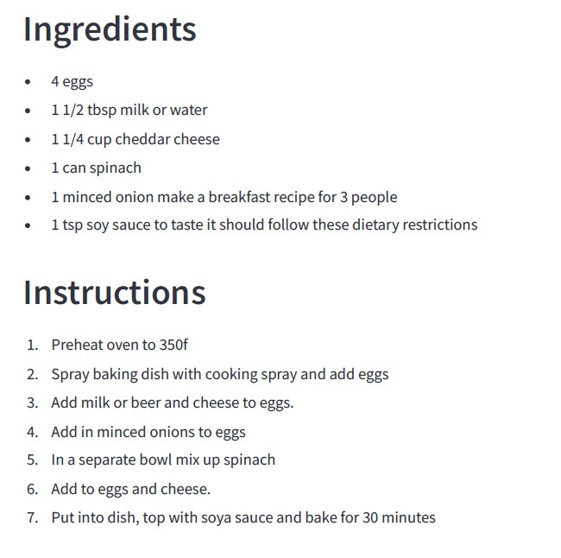
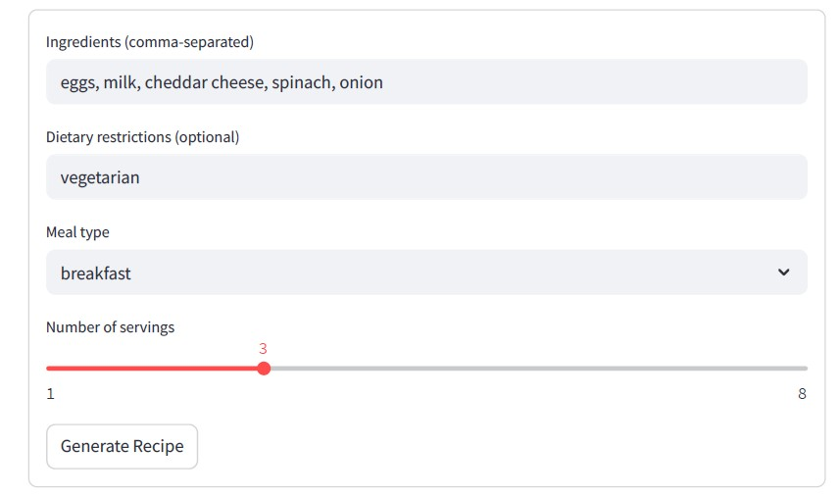
Example 1: Cheesy spinach baked eggs
Input Output
Successfully incorporated all ingredients with appropriate cooking method

Slide 8
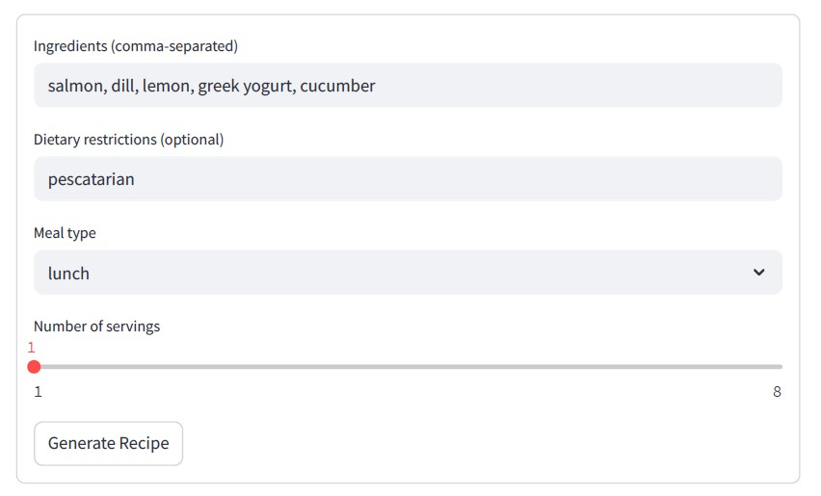
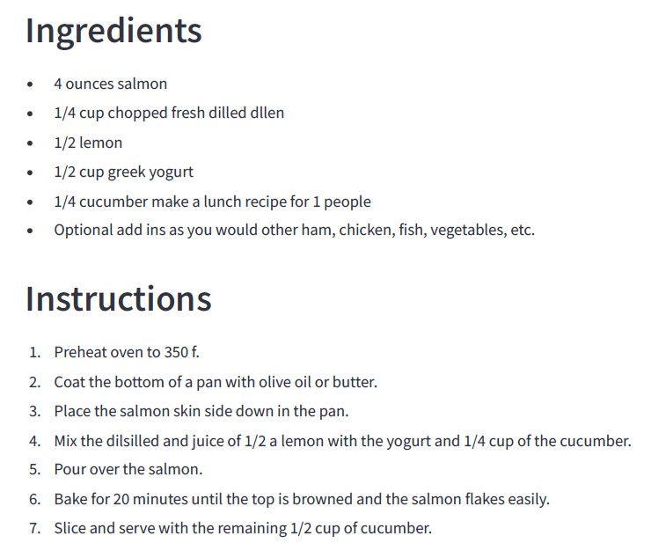
Example 2: Baked salmon with dill
Input Output
Generated complete recipe with clear instructions and cooking temperatures

Slide 9
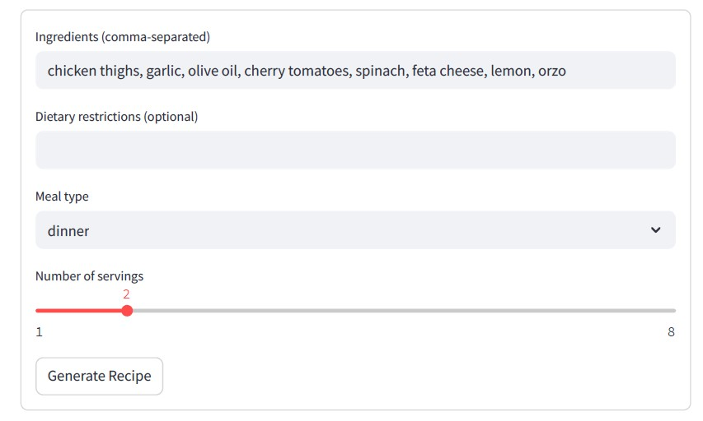
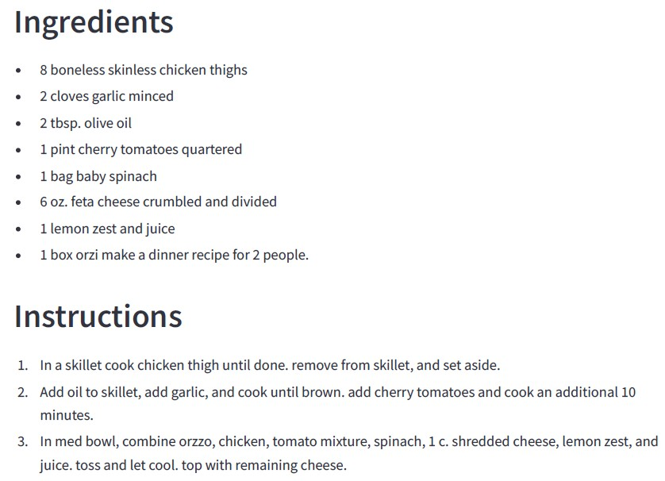
Example 3: Greek chicken orzo salad
Input Output
Demonstrates ability to handle more complex ingredient combinations

Slide 10
Results and Future Work
Achievements
High recipe success rate with complete, executable recipes
Excellent ingredient utilization efficiency
Clear, sequential cooking instructions
Proper safety compliance in cooking temperatures
Future Enhancements
Recipe images using Stable Diffusion
Nutritional information calculation
User profiles and recipe saving
Alternative ingredient suggestions
Feedback loop for recipe improvement

